Slide 1

Asha
Empowering the Challenged
- Team Incredibles

Slide 2


NEVER
GIVE
UP
Discrimination

Slide 3
NEVER
GIVE
UP
Thinking Process
Debate and discussion
Requirement gathering and analysis
Working methodology finalization
Task distribution

Slide 4
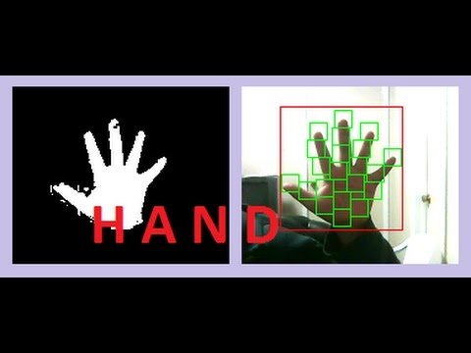
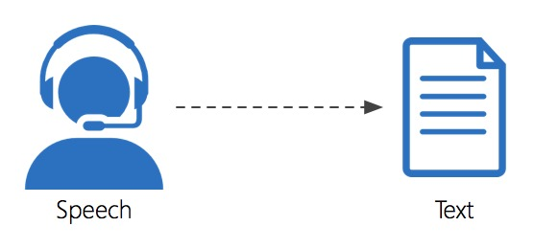

NEVER
GIVE
UP
Description
Gesture Capturing
Speech to Text
Object Detection

Slide 5
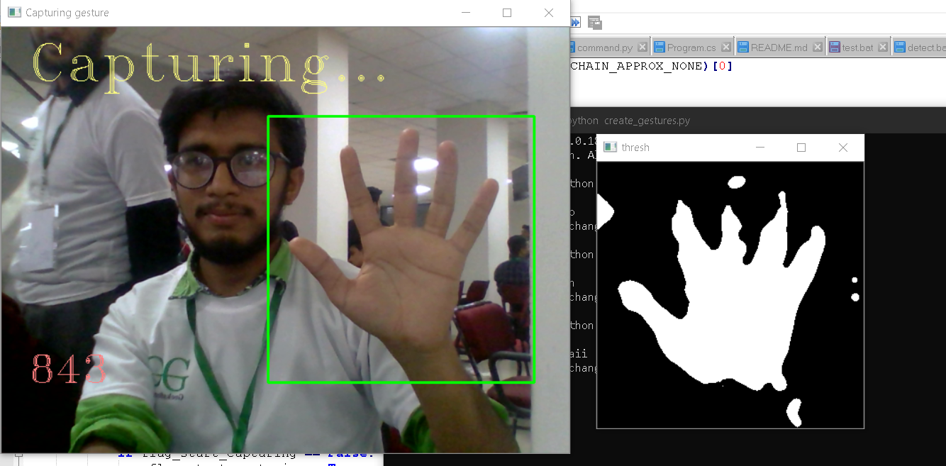
NEVER
GIVE
UP
Screenshots of the Gesture Capturing

Slide 6
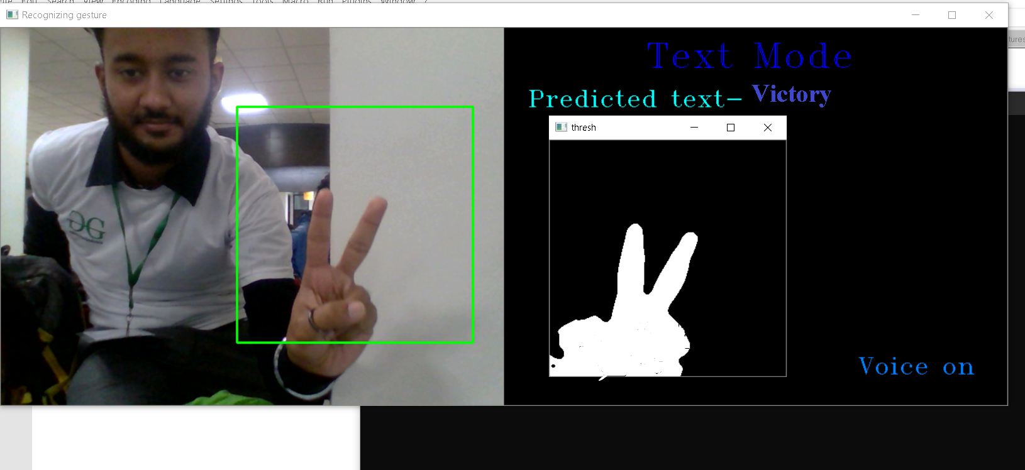
NEVER
GIVE
UP
Screenshots of the Gesture Capturing

Slide 7
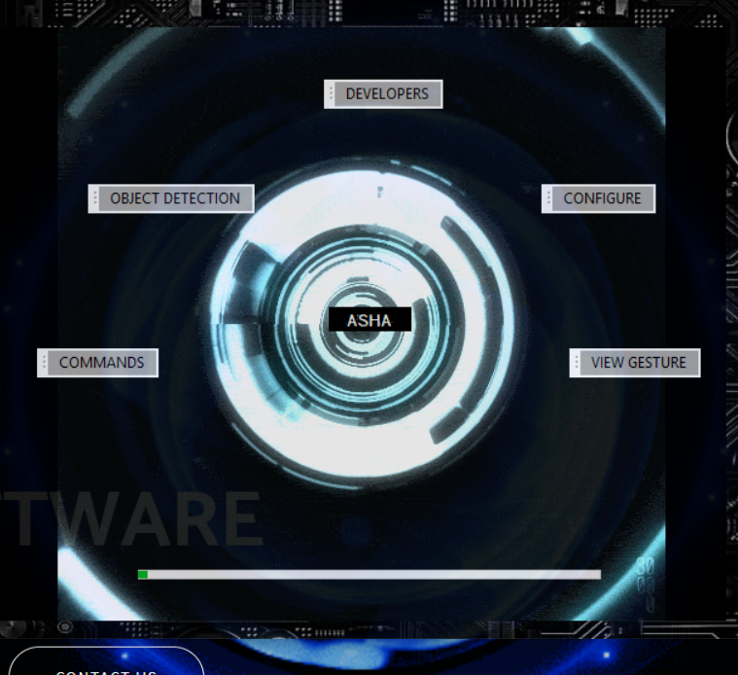

NEVER
GIVE
UP
Screenshots of the Speech To Test

Slide 8
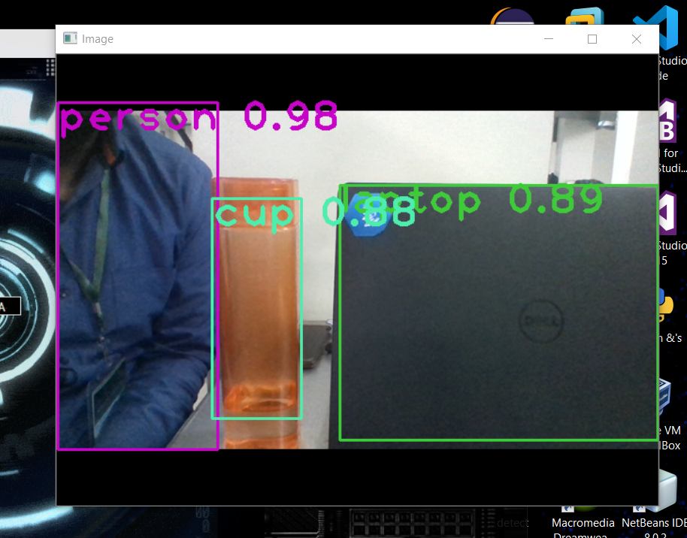
NEVER
GIVE
UP
Screenshots of the Object Detection

